Slide 1



TEAM D5 | Spark with Sparklyr
BY
ROBIN ROY - 10544522

Slide 2
Sparklyr
Apache SparkR is a data processing framework that can quickly perform processing tasks on very large data sets, and can also distribute data processing tasks across multiple computers, either on its own or in tandem with other distributed computing tools. These two qualities are key to the worlds of big data and machine learning, which require the marshaling of massive computing power to crunch through large data stores.
When we think of the computation power that Spark provides and the ease of use of the R language, it is natural to want them to work together, seamlessly. This is also what the R community expected: an R package that would provide an interface to Spark that was easy to use, compatible with other R packages, and available in CRAN. With this goal, we started developing sparklyr.
Officially, sparklyr is an R interface for Apache Spark. It’s available in CRAN and works like any other CRAN package, meaning that it’s agnostic to Spark versions, it’s easy to install, it serves the R community, it embraces other packages and practices from the R community, and so on. It’s hosted in GitHub and licensed under Apache 2.0, which allows we to clone, modify, and contribute back to this project.

Slide 3
FACTS
Sparklyr
Huge investments in big data and Hadoop
Data scientists wanting to analyse data at scale
Integrated with the RStudio IDE
Sparklyr is a dplyr back-end for Spark
Extensible foundation for Spark applications and R

Slide 4
RStudio’s Sparklyr
Sparklyr is an R package that lets we analyze data in Spark while using familiar tools in R.
Sparklyr is an open-source package that provides an interface between R and Apache Spark. We can now leverage Spark’s capabilities in a modern R environment, due to Spark’s ability to interact with distributed data with little latency.
Sparklyr is an effective tool for interfacing with large datasets in an interactive environment. This way we can benefit from the familiar tools in R in order to analyze data in Spark., giving we the best of both worlds.

Slide 5
Highlights
Interactively manipulate Spark data using both dplyr and SQL (via DBI).
Filter and aggregate Spark datasets then bring them into R for analysis and visualization.
Orchestrate distributed machine learning from R using either Spark MLlib or H2O SparkingWater.
Create extensions that call the full Spark API and provide interfaces to Spark packages.
Integrated support for establishing Spark connections and browsing Spark data frames within the RStudio IDE.

Slide 6
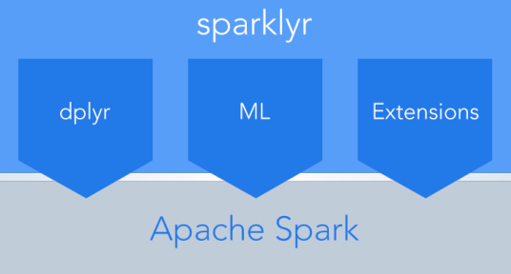
What inside Sparklyr
Sparklyr also provides interfaces to Spark’s distributed machine learning algorithms and much more.

Slide 7
Features of Sparklyr
Through Sparklyr we can use Spark as the backend for dplyr, a popular data manipulation package.
Sparklyr provides a range of functions that allow us to access the Spark tools for transforming/pre-processing data, On top of that, it also provides interfaces to Spark’s distributed machine learning algorithms and much more.
Sparklyr is also extensible. R packages that depend on Sparklyr to call the full Spark API can be created. One such extension is H2O’s Sparkling, an R package compatible with H2O’s machine learning algorithm.

Slide 8
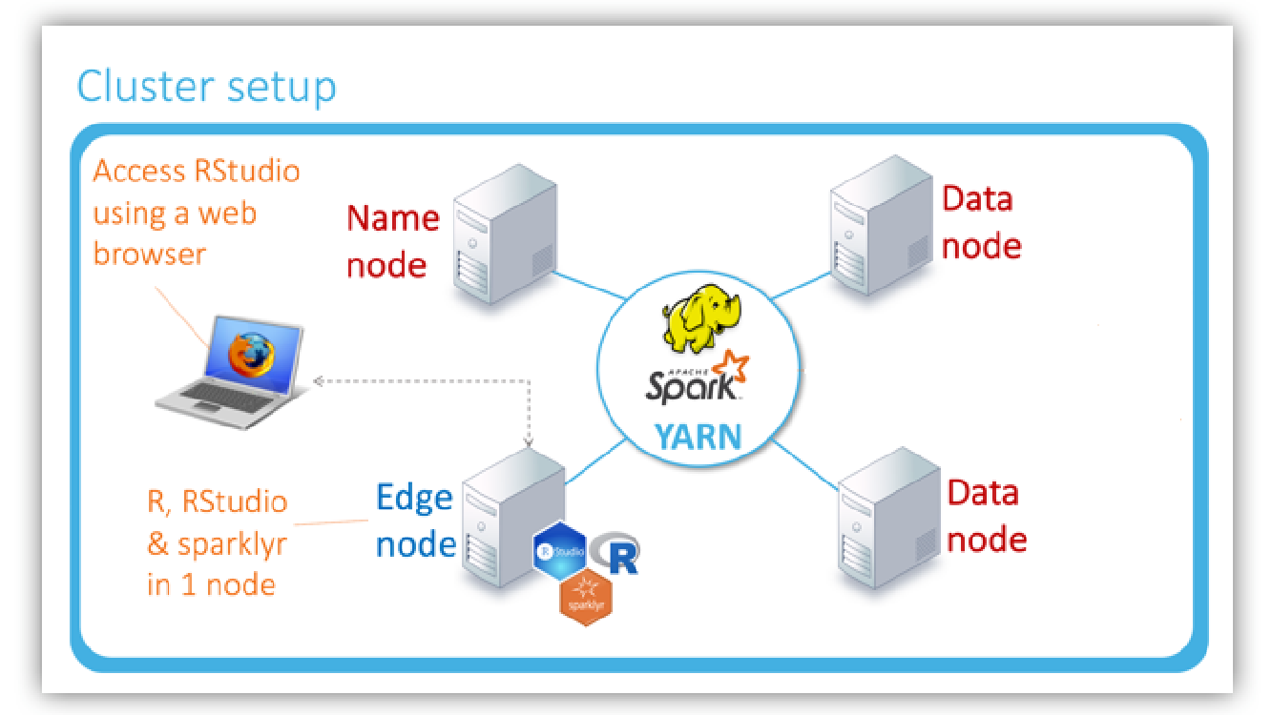
Spark cluster

Slide 9
Difference between a master node and a spark
Spark
Master Node
Master Node in Apache Spark: The machine on which the Spark Standalone cluster manager runs is called the Master Node. The resources are allocated by Master.
It uses the "Workers" running throughout the cluster for the creation of Executors for the "Driver". After that, the Driver runs tasks on Executors.
R studio running on a particular computer node which has its own memory and CPU
Spark applications run as independent sets of processes on a cluster, coordinated by the SparkContext object in were main program (called the driver program). ... Once connected, Spark acquires executors on nodes in the cluster, which are processes that run computations and store data for wer application.

Slide 10
Installing Sparkly R packages
we can install the sparklyr package from CRAN install.packages("sparklyr") we should also install a local version of Spark for development purposes:
library(sparklyr)
spark_install(version = "2.1.0")

Slide 11
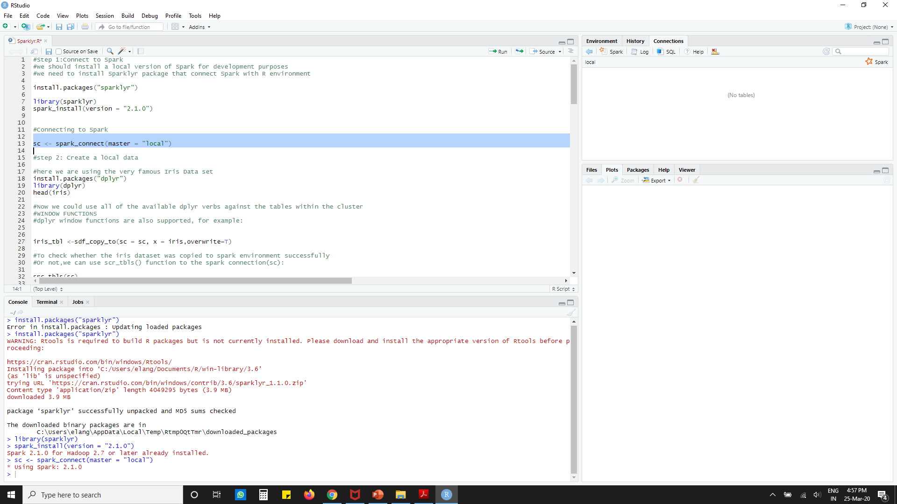
Connecting to Spark
we can then create a local spark connection to mimic we have a spark cluster here we use master =”local”option.when we connect to real spark cluster, other options are needed.
we can connect to both local instances of Spark as well as remote Spark clusters. Here we’ll connect to a local instance of Spark.
sc <- spark_connect(master = "local")
The returned Spark connection (sc) provides a remote dplyr data source to the Spark cluster.

Slide 12
Create local data
Let us use a Dataset ‘the iris dataset’. It is part of the dplyr library and lets load that Library to use iris data frame. Here is the iris data set is still in The local node where the R studio is running on.
We can install the dplyr package using the below command
install.packages("dplyr")
we can use the function using the below mentioned command
library(dplyr)
Using the head command we can able to see the column names with few rows
head(iris)

Slide 13
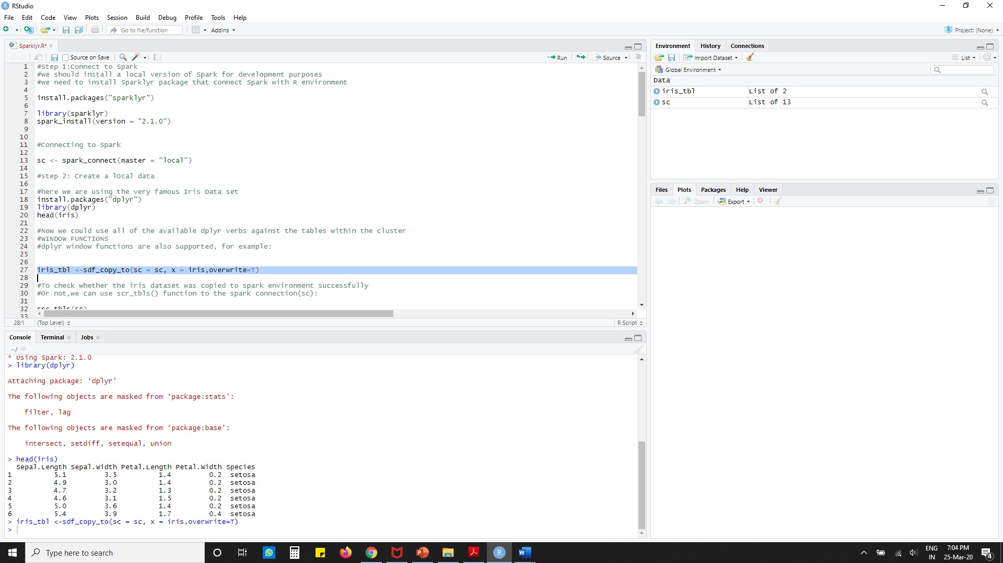
Copy data to spark
In real application, were data is usually very big and cannot fit into One hard disk and it is very likely were data is already in Hadoop/Spark Ecosystem, we can use spark Data Frame to analyse were data in Spark system.
Here is a example how to copy a local data set in the spark system already created the spark connection SC, now it is fairly easy to copy data to Spark system by sdf_copy_to() function as below:
Iris_tbl <-sdf_copy_to(sc = sc, x =iris,overwrite=T)

Slide 14
Copy data to spark
Now the data is stored in Spark cluster ..we can verify it in work space environment Global environment
Iris_tbl
To check whether the iris dataset was copied to spark environment successfully or not, we can use src_tbls() function to the spark connection(sc):
src_tbls(sc)
Now we could use all of the available dplyr verbs against the tables within the cluster
WINDOW FUNCTIONS-dplyr window functions are also supported, for example: Iris_tbl <-sdf_copy_to(sc = sc, x =iris,overwrite=T)

Slide 15
Analyze data
Now we have successfully copied the iris dataset to the spark environments. A spark dataframe and iris_tbl is an R object wrapping the iris spark dataframe and we can use iris_tbl to refer the iris dataset in the spark system(i.e. the iris spark Dataframe) we can use many function in dplyr to sparkdata frame directly through iris_tbl
For example we can count number of rows using the below command
Iris_tbl%>% count

Slide 16
Adcanced data manupulation
iris_tbl %>%
mutate(sepal_wide=ROUND(Sepal_width*2)/2)%>%# Bucketizing sepal width
group_by(Species,Sepal_width)%>%
summarize(count=n(),Sepal_Length=mean(sepal_Length),stdev=sd(sepal_Length))

Slide 17
Collect data back to Master Node
Even though we can run many of the dplyr functions on spark dataframe, we cannot apply functions from other packages to spark dataframe directly(such as ggplot)
For functions that can only work on local R data frames, we must copy the spark data frame back to the local node, To copy spark dataframe back to the local node, we use the collect() function where the argument to it is the name of the spark dataframe.
iris_summary<-iris_tbl %>%
mutate(sepal_wide=ROUND(Sepal_width*2)/2)%>%
group_by(Species,Sepal_width)%>%
summarize(count=n(),Sepal_Length=mean(sepal_Length),
stdev=sd(sepal_Length))%>% collect

Slide 18
Using collected variable as local variable
now iris_summary is a local variable to the R studio and we can use all R packages and functions to it.
In the following code, we will apply ggplot() to the collected data, exactly the same as a stand a long R console
library(ggplot2)
ggplot(iris_summary, aes(Sepal_width, Sepal_Length,color=Species))+ geom_line(size=1.2)+geom_errorbar(aes(ymin=Sepal_Length-stdev,ymax=Sepal_Length+stdev),width=0.05)+geom_text(aes(label=count),vjust=-0.2,hjust=1.2,color="Black")+theme(legend.position="top")

Slide 19
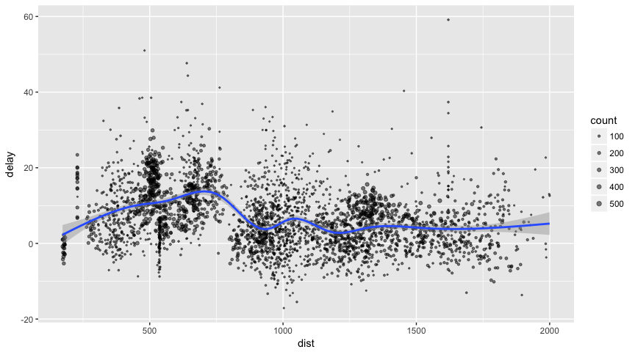
Cont.

Slide 20
Using Dplyr
We can now use all of the available dplyr verbs against the tables within the cluster.
We’ll start by copying some datasets from R into the Spark cluster (note that we may need to install the nycflights13 and Lahman packages in order to execute this code):
install.packages(c("nycflights13", "Lahman")) library(dplyr) iris_tbl <- copy_to(sc, iris) flights_tbl <- copy_to(sc, nycflights13::flights, "flights") batting_tbl <- copy_to(sc, Lahman::Batting, "batting") src_tbls(sc)

Slide 21
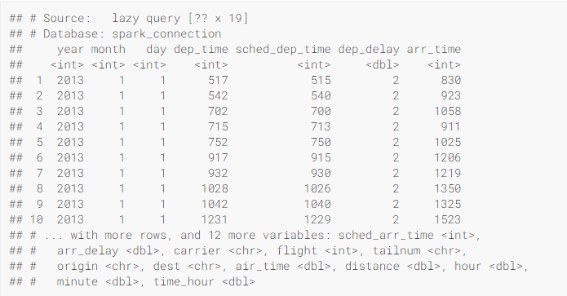
Using dplyr example - filtering
flights_tbl %>% filter(dep_delay == 2)

Slide 22
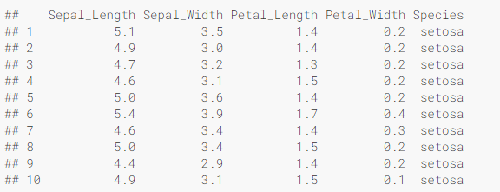
Using SQL
It’s also possible to execute SQL queries directly against tables within a Spark cluster. The spark_connection object implements a DBI interface for Spark, so we can use dbGetQuery to execute SQL and return the result as an R data frame:
library(DBI) iris_preview <- dbGetQuery(sc, "SELECT * FROM iris LIMIT 10") iris_preview

Slide 23
Machine Learning
we can orchestrate machine learning algorithms in a Spark cluster via the machine learning functions within sparklyr. These functions connect to a set of high-level APIs built on top of DataFrames that help we create and tune machine learning workflows.
# copy mtcars into spark mtcars_tbl <- copy_to(sc, mtcars)
# transform our data set, and then partition into 'training', 'test'
partitions <- mtcars_tbl %>%
filter(hp >= 100) %>%
mutate(cyl8 = cyl == 8) %>%
sdf_partition(training = 0.5, test = 0.5, seed = 1099)
# fit a linear model to the training dataset fit <- partitions$training %>% ml_linear_regression(response = "mpg", features = c("wt", "cyl"))
fit

Slide 24
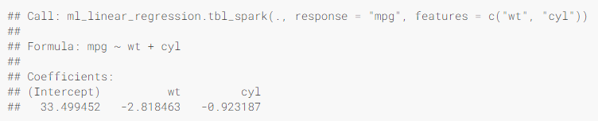
Machine Learning..
Here’s an example where we use ml_linear_regression to fit a linear regression model. We’ll use the built-in mtcars dataset, and see if we can predict a car’s fuel consumption (mpg) based on its weight (wt), and the number of cylinders the engine contains (cyl). We’ll assume in each case that the relationship between mpg and each of our features is linear.

Slide 25
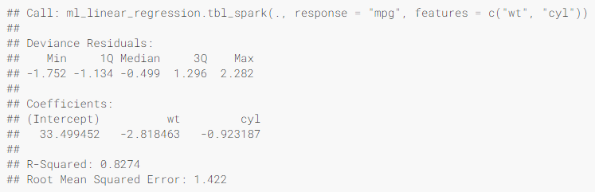
For linear regression models produced by Spark, we can use summary() to learn a bit more about the quality of our fit, and the statistical significance of each of our predictors.
summary(fit)
Spark machine learning supports a wide array of algorithms and feature transformations and as illustrated above it’s easy to chain these functions together with dplyr pipelines.

Slide 26
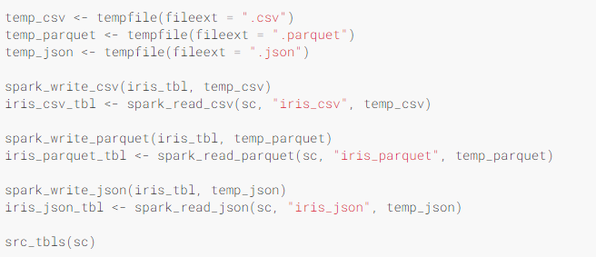
Reading and Writing Data
we can read and write data in CSV, JSON, and Parquet formats. Data can be stored in HDFS, S3, or on the local file system of cluster nodes.
## [1] "batting" "flights" "iris" "iris_csv"
## [5] "iris_json" "iris_parquet" "mtcars"

Slide 27

Extensions
The facilities used internally by sparklyr for its dplyr and machine learning interfaces are available to extension packages. Since Spark is a general purpose cluster computing system there are many potential applications for extensions (e.g. interfaces to custom machine learning pipelines, interfaces to 3rd party Spark packages, etc.).
library(sparklyr)
count_lines <- function(sc, file) {
spark_context(sc) %>%
invoke("textFile", file, 1L) %>%
invoke("count")
}
The count_lines function takes a spark_connection (sc) argument which enables it to obtain a reference to the SparkContext object, and in turn call the textFile().count() method.
we can use this function with an existing sparklyr connection as follows:

Slide 28
Conclusion
Spark is as a modern and powerful computing platform, R as an easy-to-use computing language with solid foundations in statistical methods, and sparklyr as a project bridging both technologies and communities. In a world in which the total amount of information is growing exponentially, learning how to analyze data at scale will help we to tackle the problems and opportunities humanity is facing today….

Slide 29
References
Rstudio.com
youtube
THANKS!
Any questions?
TEAM MEMBERS
ROBIN ROY – 10544522

